Slide 1
Android Application Development (I)
Practice – Android Introduction

Slide 2
Agenda
Self Introduction
Intellectual Property Rights
Project Introduction
Android Introduction
Get Started with Android
Requirement
Object-Oriented Analysis and Design
Scrum
Project Breakdown
Acceptance Test Criteria
Publish Application

Slide 3
Outline
Android System Architecture
Android Application Composition

Slide 4
What is Android
Android is a software stack for mobile devices that includes an operating system, middleware and key applications.
The Android SDK provides the tools and APIs necessary to begin developing applications on the Android platform using the Java programming language.

Slide 5
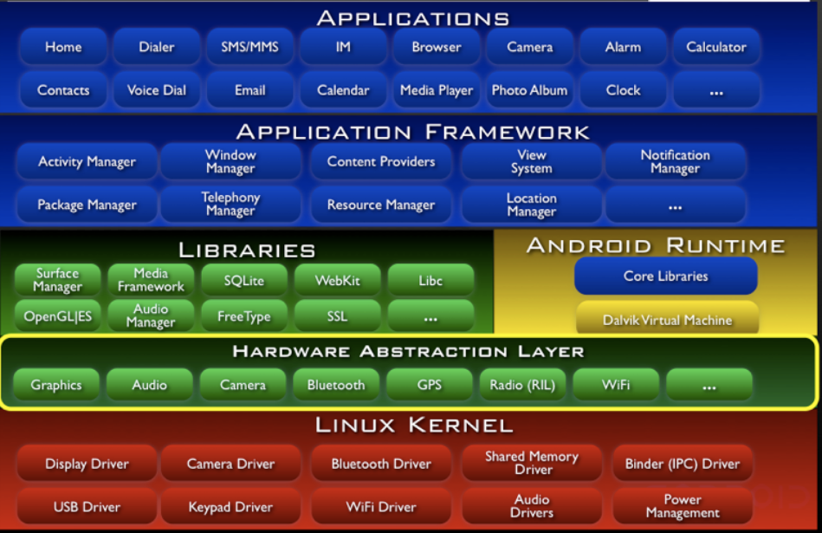
Architecture Overview
Java
Apache 2
C++
C
GPL

Slide 6
Outline
Android System Architecture
Android Application Composition

Slide 7
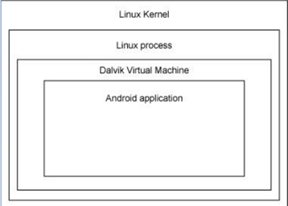
Application Overview
Android apps are written in the Java programming language.
The Android SDK tools compile your code—along with any data and resource files—into an APK: an Android package, which is an archive file with an .apk suffix.
One APK file contains all the contents of an Android app and is the file that Android-powered devices use to install the app.

Slide 8
Application Components
Each Android app lives in its own security sandbox
App 1
App n
Activity 1
Activity …
Activity 1
Activity …
UI
UI
UI
UI
UI
UI
UI
UI
Services
Services
Content Provider
Content Provider
Broadcast Receiver
Broadcast Receiver
Android Runtime
DVM / ART
Notes:
This is a simple, basic, app shot.
An app, normally, built by 4 parts, Activitiy, Service, CP, BroadcastReceiver.
Activiy provide some basic UI logical here, UI component also be included in acivity.
Service provide some real work logic here, it can be run on his own process or others
CP provide the data app used, all service data can be save and read from CP.
BR, normally, if you want to do something under some specil condition, you need to write some codes here. E.g. we want to popup something when phone battery is lower than 10%
Every application don’t need to include these 4 module totally. It depends on your requirements.

Slide 9
The Glue: Intent
An Intent is a messaging object you can use to request an action from another app component.
To start an activity
Start a new instance of an Activity by passing an Intent to startActivity()
To start a service
Start a service to perform a one-time operation by passing an Intent to startService()
To deliver a broadcast
Deliver a broadcast to other apps by passing an Intent to sendBroadcast()

Slide 10
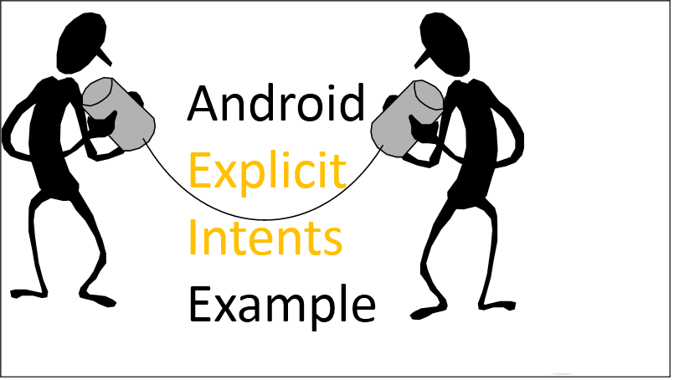
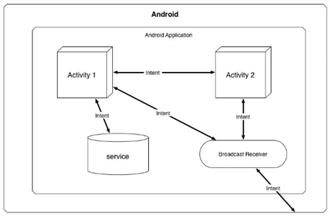
Explicit Intent vs. Implicit Intent
Explicit Intent: typically to start a component in your own app, because you know the class name of the activity or service you want to start
Implicit Intent: typically to start a component in other apps, because you tell system an action to perform, and then reach on the other apps
0

Slide 11
Reference
Android Developer:
http://developer.android.com/index.html

